Slide 1
JOB SEQUENCING WITH DEADLINES
Greedy Algorithm
Kaustubh Kulkarni

Slide 2





Kaustubh Kulkarni

Slide 3
Scenario
Imagine you're a freelancer who gets multiple project offers with different deadlines and payouts.
Each project must be completed in one day.
You cannot work on more than one project per day.
Your goal: Maximize earnings while meeting deadlines.
Kaustubh Kulkarni

Slide 4
Example 1
Job | Project | Deadline (days to complete) | Profit ($)
J1 | Design a website | 2 days | $100
J2 | Fix minor bugs | 1 day | $10
J3 | Write a blog post | 2 days | $15
J4 | Create a logo | 1 day | $27
Kaustubh Kulkarni

Slide 5
Solution
Sr.No. Feasible Processing Profit value
Solution Sequence
(i) (1,2) (2,1) 110
(ii) (1,3) (1,3) or (3,1) 115
(iii) (1,4) (4,1) 127
(iv) (2,3) (2,3) 25
(v) (3,4) (4,3) 42
(vi) (1) (1) 100
(vii) (2) (2) 10
(viii) (3) (3) 15
(ix) (4) (4) 27
OPTIMAL SOLUTION
Kaustubh Kulkarni

Slide 6
Problem Statement
There are n jobs to be processed on a machine.
Each job i has a deadline d_{i}≥ 0 and profit p_{i}≥0 .
Pi is earned iff the job is completed by its deadline.
The job is completed if it is processed on a machine for unit time.
Only one machine is available for processing jobs.
Only one job is processed at a time on the machine.
Kaustubh Kulkarni

Slide 7
Greedy Approach
A feasible solution is a subset of jobs J such that each job is completed by its deadline.
An optimal solution is a feasible solution with maximum profit value.
Kaustubh Kulkarni

Slide 8
Example : Let n = 4, (p₁,p₂,p₃,p₄) = (100,10,15,27), (d₁,d₂,d₃,d₄) = (2,1,2,1)
(Already solved in the previous slides)
Kaustubh Kulkarni

Slide 9
GREEDY ALGORITHM TO OBTAIN AN OPTIMAL SOLUTION (Contd..)
J = { 1} is a feasible one
J = { 1, 4} is a feasible one with processing sequence ( 4,1)
J = { 1, 3, 4} is not feasible
J = { 1, 2, 4} is not feasible
J = { 1, 4} is optimal
Kaustubh Kulkarni

Slide 10
GREEDY ALGORITHM TO OBTAIN AN OPTIMAL SOLUTION
Consider the jobs in the non increasing order of profits subject to the constraint that the resulting job sequence J is a feasible solution.
Kaustubh Kulkarni

Slide 11
GREEDY ALGORITHM TO OBTAIN AN OPTIMAL SOLUTION (Contd..)
Theorem1: Let J be a set of K jobs and
σ = (i₁,i₂,….i_{k}) be a permutation of jobs in J such that di₁ ≤ di₂ ≤…≤ di_{k}.
J is a feasible solution iff the jobs in J can be processed in the order σ without violating any deadline.
Theorem2:The Greedy method obtains an optimal solution to the job sequencing problem.
Kaustubh Kulkarni

Slide 12
Edge Case 1:
Multiple Jobs with Same Profit
Project | Profit | Deadline
P1 | $50 | 2
P2 | $50 | 3
P3 | $50 | 1
P4 | $50 | 2
Kaustubh Kulkarni

Slide 13
All projects have equal profits but different deadlines.
The greedy approach by profit doesn’t differentiate, so we need a tiebreaker.
Solution: When profits are equal, prioritize the one with an earlier deadline (so later slots remain free for longer-deadline jobs).
Kaustubh Kulkarni

Slide 14
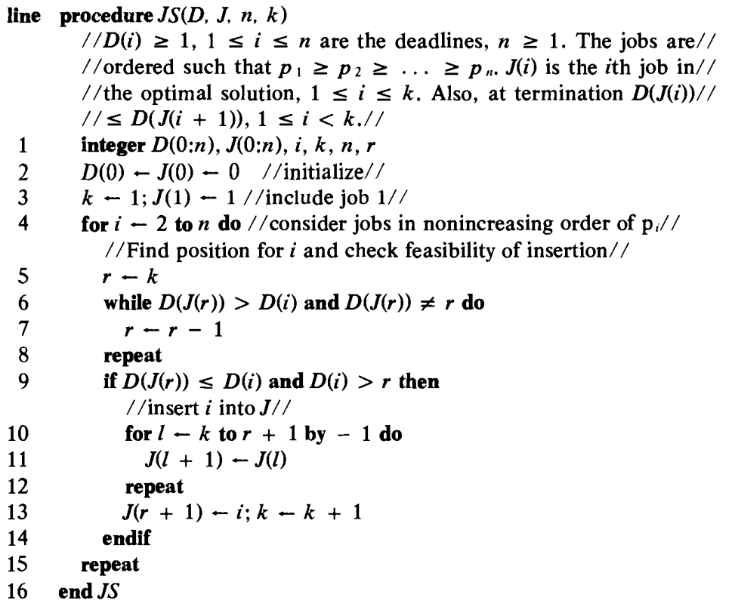
GREEDY ALGORITHM FOR SEQUENCING UNIT TIME JOBS (Contd..)
Kaustubh Kulkarni

Slide 15
The algorithm assumes that jobs are already sorted by profit in descending order.
Job | Project | Deadline (days to complete) | Profit ($)
J1 | Design a website | 2 days | $100
J4 | Create a logo | 1 day | $27
J3 | Write a blog post | 2 days | $15
J2 | Fix minor bugs | 1 day | $10
Kaustubh Kulkarni

Slide 16
Initialization (Lines 1-2)
D[] Keeps track of time slots occupied
D[0] ← 0
J[] Stores the final sequence of selected jobs
J[0] ← 0
J[1] ← 1
k ← 1 : Number of scheduled jobs (initially 1)
Kaustubh Kulkarni

Slide 17
Loop (lines 4 to 15)
Iteration 1: Schedule J1 (p = 100, d = 2)
Since slot 2 is empty, J1 is scheduled at time slot 2.
Job sequence so far: _ J1
Kaustubh Kulkarni

Slide 18
Iteration 2: Schedule J4 (p = 27, d = 1)
Slot 1 is empty, so J4 is scheduled at slot 1.
Job sequence so far: J4 J1
Kaustubh Kulkarni

Slide 19
Iteration 3: Schedule J3 (p = 15, d = 2)
D[J[r]] = 2, but slot 2 is occupied by J1.
Move backwards to r = 1.
D[J[1]] = 1, but slot 1 is occupied by J4.
No available slots (r = 0) → J3 is rejected ❌.
Job sequence remains: J4 J1
Kaustubh Kulkarni

Slide 20
Iteration 4: Schedule J2 (p = 10, d = 1)
D[J[1]] = 1, but slot 1 is occupied by J4.
No available slots (r = 0) → J2 is rejected ❌.
Final Job sequence: J4 J1
Kaustubh Kulkarni

Slide 21
Iterating Over Remaining Jobs (Lines 4-15)
Processing J4 (Profit = 27, Deadline = 1)
Find the latest available slot ≤ deadline (1)
r = 1
(Position to check for inserting new job)
Since D(1) ≤ 1, we place J4 in slot 1
J(2) = 4, k = 2
Kaustubh Kulkarni

Slide 22
Solve
Job | Project | Deadline (days to complete) | Profit
J1 | Develop a mobile app | 5 | $200
J2 | Write technical documentation | 3 | $180
J3 | Create a presentation | 3 | $190
J4 | Conduct user testing | 2 | $300
J5 | Create a social media strategy | 4 | $120
J6 | Proof Read | 2 | $100
Kaustubh Kulkarni

Slide 23
COMPLEXITY ANALYSIS OF JS ALGORITHM
Let n be the number of jobs and s be the number of jobs included in the solution.
The loop between lines 4-15 (the for-loop) is iterated (n-1)times.
Each iteration takes O(k) where k is the number of existing jobs.
The time needed by the algorithm is O(sn)
Since s ≤ n so the worst-case time is O(n²).
If d_{i} = n - i+1 1 ≤ i ≤ n, JS takes θ(n²) time
D and J need θ(s) amount of space.
Kaustubh Kulkarni

Slide 24
A FASTER IMPLEMENTATION OF JS
The time of JS can be reduced from O(n²) to O(n) by using SET UNION and FIND algorithms and using a better method to determine the feasibility of a partial solution.
Kaustubh Kulkarni

Slide 25
A FASTER IMPLEMENTATION OF JS (Contd..)
If J is a feasible subset of jobs, we can determine the processing time for each of the jobs using the following rule.
If job i has not been assigned a processing time, then assign it to slot [α -1, α] where α is the largest integer r such that 1 ≤ r ≤ d_{i} and the slot [α -1, α] is free.
If there is no such α, then the new job is not included.
Kaustubh Kulkarni

Slide 26
EXAMPLE: let n = 5, (p₁,…, p₅) = (20,15,10,5,1) and (d₁,…,d₅) =
(2,2,1,3,3).
J assigned slot jobs being considered assigned to
Ø none 1 [1, 2]
{1} [ 1,2] 2 [0,1]
{1,2} [0,1],[1,2] 3 cannot fit; reject as [0,1] is not free
{1,2} [0,1],[1,2] 4 assign to [2,3]
{1,2,4} [0,1],[1,2],[2,3] 5 reject
The optimal solution is {1,2,4}
Kaustubh Kulkarni

